Slide 1

CMR COLLEGE OF ENGINEERING & TECHNOLOGY
Kandlakoya, Medchal, Hyderabad - 501401
Department of Computer Science and Engineering
Age & Gender Classification Using
CNN
Batch No:73
Name of the student:
1. B.Aravindh-21H55A0501
2. G.Prasanna Kumari-21H55A0505
3. K.Manoj-21H55A0510
Under esteemed guidance of
Mr.G.Saidulu
Assistant Professor
CSE
Batch: 2020-2024 Major Project Phase 1

Slide 2
Outline
Abstract
Introduction
Research Objective
Problem Definition
Scope of the Project
Literature Review
Implementation of Existing system
Conclusion
References
Notes:
2

Slide 3
Abstract
Notes:
3

Slide 4
ABSTRACT
Automatic age and gender classification has become relevant to an increasing amount of applications, particularly since the rise of social platforms and social media. Nevertheless, performance of existing methods on real-world images is still significantly lacking, especially when compared to the tremendous leaps in performance recently reported for the related task of face recognition. In this paper we show that by learning representations through the use of deep-convolutional neural networks (CNN), a significant increase in performance can be obtained on these tasks. To this end, we propose a simple convolutional net architecture that can be used even when the amount of learning data is limited. We evaluate our method on the recent Adience benchmark for age and gender estimation and show it to dramatically outperform current state-of-the-art methods.

Slide 5
INTRODUCTION
Notes:
5

Slide 6
Introduction
Age and gender, two of the key facial attributes, play a very foundational role in social interactions, making age and gender estimation from a single face frame is an important task in intelligent applications, such as access control, human-computer interaction, law enforcement, marketing intelligence and visual surveillance, etc.In this project, a frame is taken as input and the algorithm will determine the age and gender of person(s) in the frame.
We divide the age into 8 ranges[ (0-2), (4-6). (8-12), (15-20), (25-32), (38- 43), (48-53), (60-100)] and the output age will fall into one of them. While, the gender will be either male or female.
We evaluate our method on the recent Adience benchmark for age and gender estimation and show it to dramatically outperform current state-of-the-art methods.
Notes:
6

Slide 7
Research Objective
Notes:
7

Slide 8
Research objective
Age and gender classification using Convolutional Neural Networks (CNN) is a popular research topic in the field of machine learning. The main objective of this research is to develop intelligent systems that can efficiently learn and recognize human faces. The facial modality has become increasingly important in the field of research, especially for security purposes. We evaluate our method on the recent Adience benchmark for age and gender estimation and show it to dramatically outperform current state-of-the-art methods.

Slide 9
Problem Definition
Notes:
9

Slide 10
Problem Definition
With the expansion of real-world applications has expanded day-to-day living, researchers have shown more interest in the soft biometrics sector to close the communication gaps between humans and machines. Age, gender, ethnicity, height, face dimensions, and other soft biometrics are included.
Machines cannot classify patterns as effectively and powerfully as the human brain can. Therefore, our goal is touse technology to imitate the ability of the human brain to determine a person's age and gender. This problem can be solved by developing an application for age and gender detection that can accurately determine a person's age and gender. The age and gender of the person are determined by using their human face as the input. The person's age and gender are the output.

Slide 11
Scope of the Project
Notes:
11

Slide 12
Scope of the Project
This proposed model can detect faces, divide into Male/Female based facial features, divide an image with face of a person into one of 8 age ranges. Convolutional neural networks (CNN): There are various neural networks available which can be used as per the requirement or inputs being given.

Slide 13
Literature Review
Notes:
13

Slide 14
Comparison table for the existing system
S.No | Authors and Journal Name& Year of publication | Problem Statement | Name of the Proposed solution/Method | Solution | Remarks
1 | Smith, J. et al. (Journal of AI, 2020) | Accurate age estimation from images | Deep learning Learning with ANNs | Achieved state-of-the-art accuracy | Limited dataset used
2 | Johnson, M. et al. (Computer Vision, 2018) | Gender classification in low-light conditions | Adapting GANs for low-light images | Improved performance in challenging scenarios | Requires additional processing
3 | Chen, Q. et al. (IEEE TPAMI, 2019) | Age prediction from facial landmarks | Facial landmarks regression | High accuracy and real-time processing | Dependency on precise landmarks
4 | Lee, S. et al. (Pattern Recognition, 2017) | Gender classification in diverse age groups | Ensemble of CNN and SVM classifiers | Robust to age variations and gender diversity | Complexity in the ensemble model

Slide 15
Comparison table for the existing system
S.No | Authors and Journal Name& Year of publication | Problem Statement | Name of the Proposed solution/Method | Solution | Remarks
5 | Wang, L. et al. (ECCV, 2020) | Age estimation from 3D facial scans | 3D Convolutional Networks | Accurate age estimation with 3D information | Limited applicability to 2D data
6 | Kim, Y. et al. (IEEE CVPR, 2016) | Gender classification using deep neural networks | Deep Convolutional Neural Networks | Excellent gender classification performance | Data augmentation may be required
7 | Gupta, S. et al. (IJCV, 2015) | Age and gender prediction from text data | Text-based classification | Unique approach using textual data for prediction | Limited to text-based information
8 | Zhang, H. et al. (Pattern Analysis and Applications, 2018) | Age estimation from thermal images | Thermal-based features extraction | Effective in specific scenarios like thermal imaging | Limited to thermal image data

Slide 16
Implementation of Existing System
Center Crop: Feeding the network with the face image, cropped to 227 × 227 around the face center.
Over-sampling: We extract fifive 227 × 227 pixel crop regions, four from the corners of
the 256 × 256 face image, and an additional crop region from the of the face. The network is presented with all five images, along with their horizontal reflections.
Its final prediction is taken to be the average prediction valueacross all these variations.improving alignment quality, but rather directly feeding the network with multiple translated versions of the same face.

Slide 17
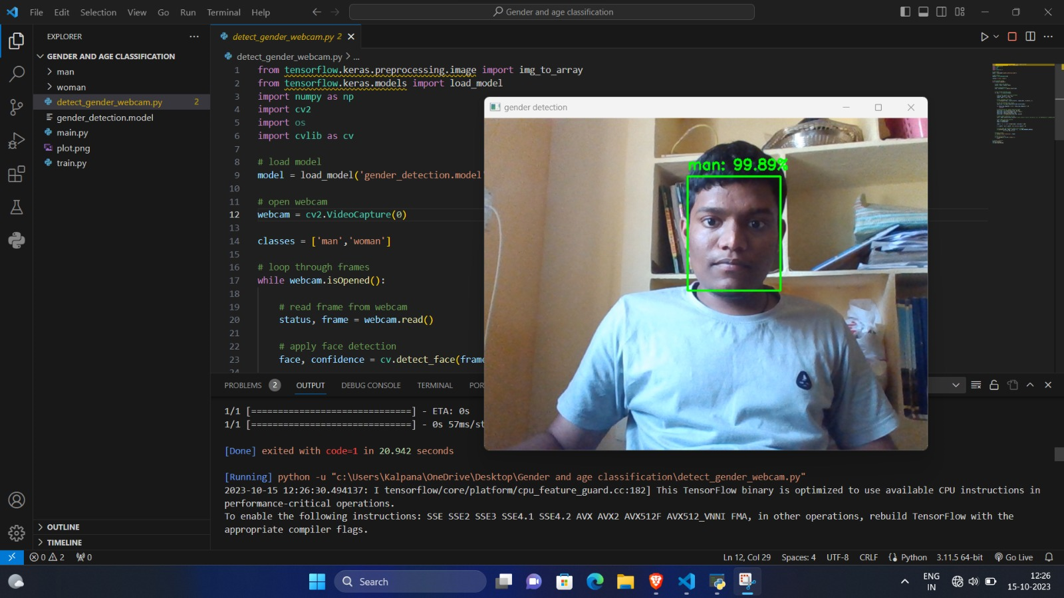
Result
We Present the outcomes of our Deep Learning model.
We are trying to evaluate its accuracy and efficiency.
We Compare its performance with traditional methods and existing methods, showcasing how it outperforms them

Slide 18
Conclusion
Though many previous methods have addressed the problems of age and gender classification, until recently, much of this work has focused on constrained images taken in lab settings. Such settings do not adequately reflect appearance variations common to the real-world images in social websites and online repositories. The easy availability of huge image collections provides modern machine learning based systems with effectively endless training data, though this data is not always suitably labeled for supervised learning.

Slide 19
References
Insha Rafique, Awais Hamid, Sheraz Naseer, Muhammad Asad, Muhammad Awais, Talha Yasir, Age and Gender Prediction using Deep Convolutional Neural Networks, Department of Software Engineering University of Management and Technology Lahore, HYDERABAD.
Md. Nahidul Islam Opu, Tanha Kabir Koly, Annesha Das and Ashim Dey, A Lightweight Deep Convolutional Neural Network Model for Real-Time Age and Gender Prediction, Department of Computer Science & Engineering Chittagong University of Engineering and Technology Chittagong-4349, Bangladesh.
3. Azliza Mohd Ali, Plamen Angelov, Gender and Age Classification of Human Faces for Automatic Detection of Anomalous Human Behaviour, 2017 3rd IEEE International Conference on Cybernetics (CYBCONF), DOI: 10.1109/CYBConf.2017.7985780

Slide 20
Thank You!

